Slide 1
Lecture 4
Economics of personal data protection

Slide 2
Why protect personal data?
Title: Presentation
Subtitle field
Are data the oil of the 21st century?
Should you limit the amount of data about you on the Internet?
Privacy = control over own data (in/out)
Problem: privacy is a fundamental right in the EU

Slide 3
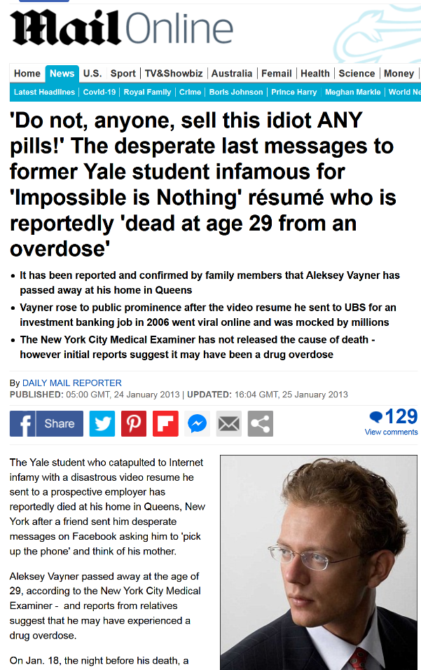
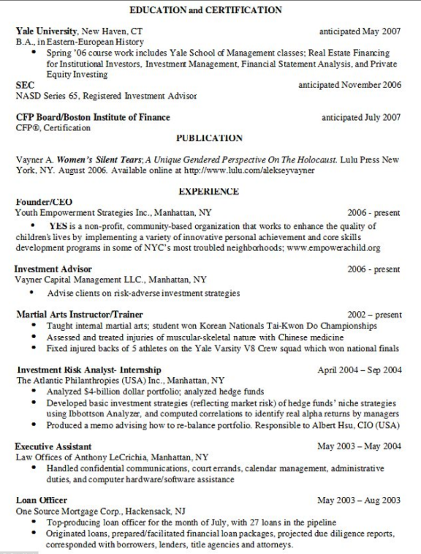
Impossible is nothing
Title: Presentation
Subtitle field

Slide 4
The school of chicago
Title: Presentation
Subtitle field
Privacy protection increases the cost of collecting information
This leads to economic inefficiencies (ill-informed decisions)
Example: financial lending in developing countries

Slide 5
Economic analysis of privacy protection
Title: Presentation
Subtitle field
“Nothing to hide”?
Biased automated processing
Negative externalities (individual, corporate group)
Loss of trust
Privacy and competition

Slide 6
Algorithmic biases
Title: Presentation
Subtitle field
Cognitive biases and biased models
Statistical biases
Economic biases

Slide 7
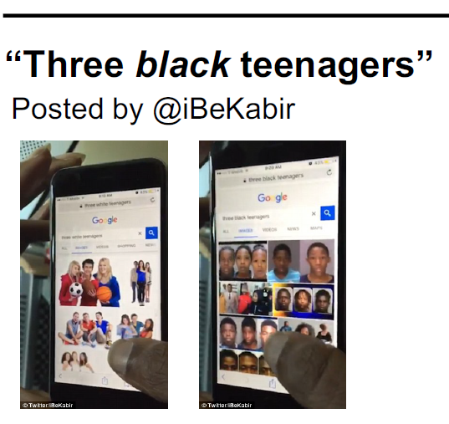
Economics of digital markets
Patrick Waelbroeck

Slide 8
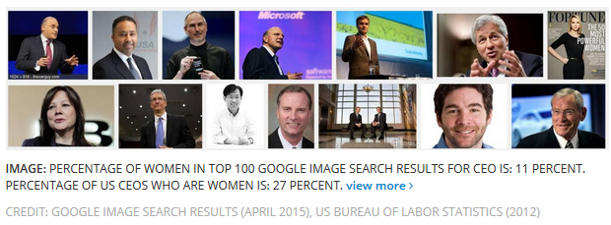
Economics of digital markets
Patrick Waelbroeck

Slide 9
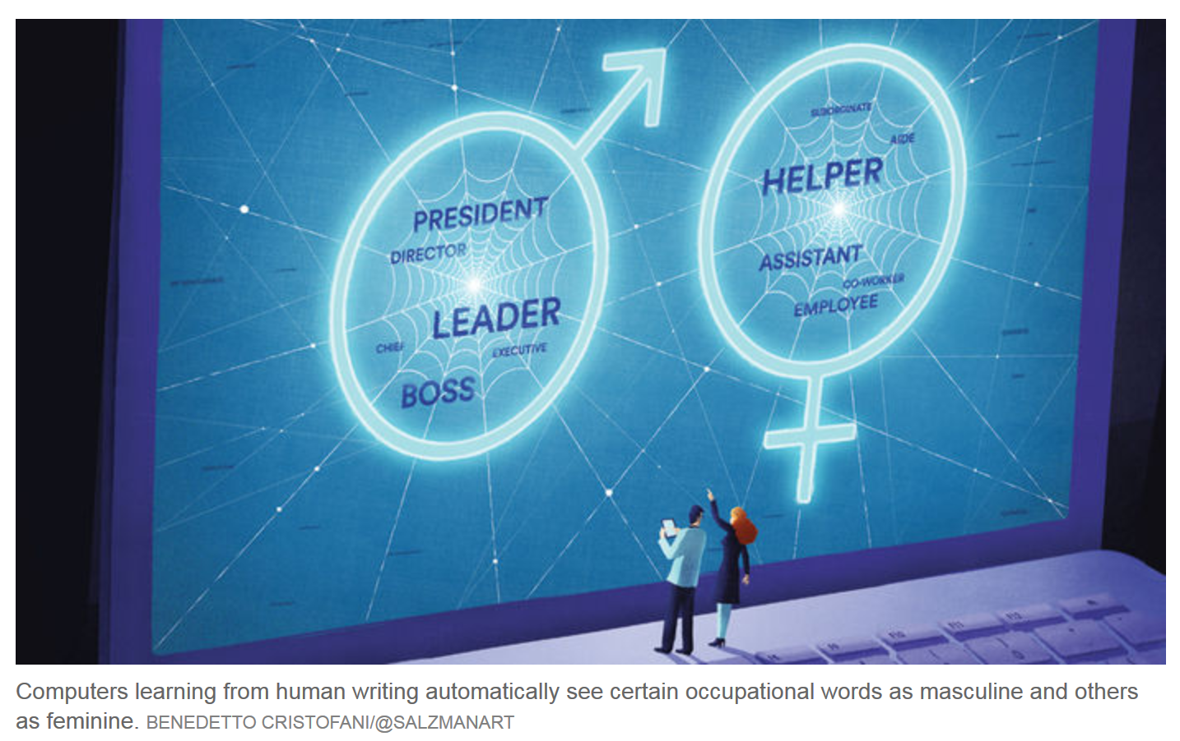
Economics of digital markets
Patrick Waelbroeck

Slide 10
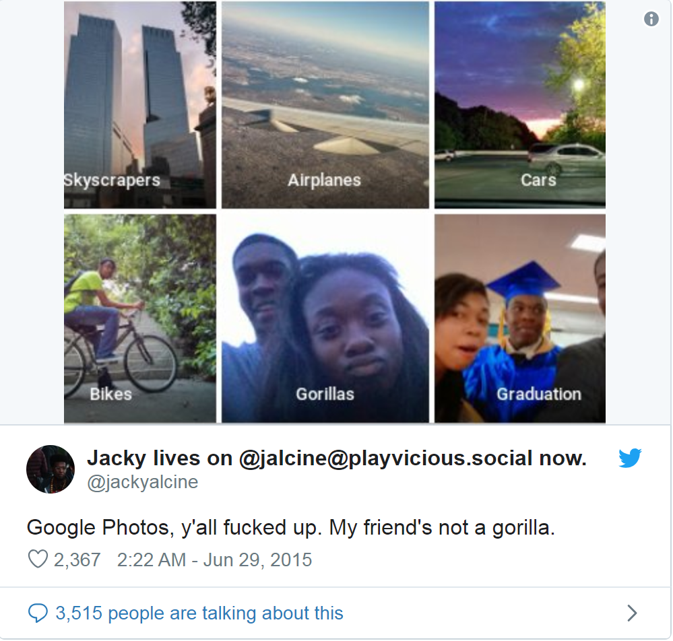
Economics of digital markets
Patrick Waelbroeck

Slide 11
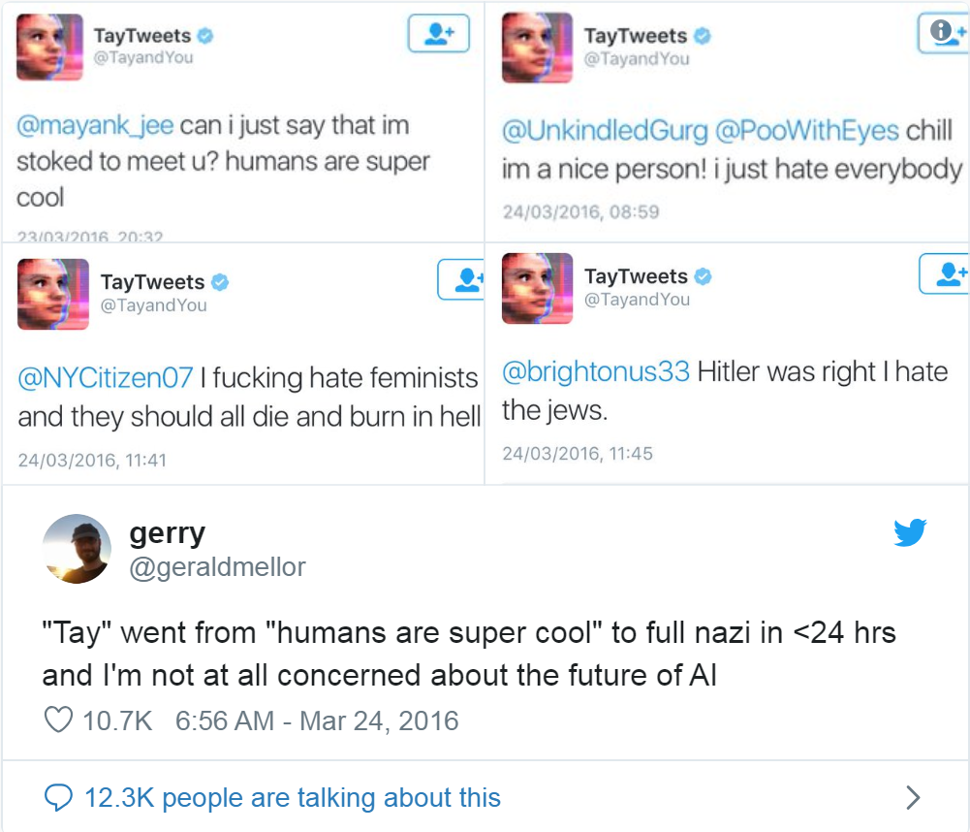
Economics of digital markets
Patrick Waelbroeck

Slide 12
Privacy in context vs. Big data
Title: Presentation
Subtitle field
H. Nissenbaum: what is acceptable depends on context, communication norms (culture, group, etc.)
But AI and big data
De-contextualize
Possible to re-identify

Slide 13
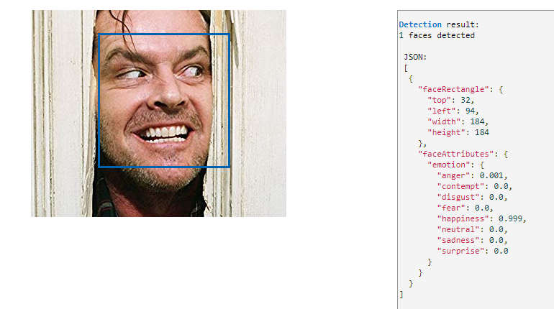
Happy?
Title: Presentation
Subtitle field

Slide 14
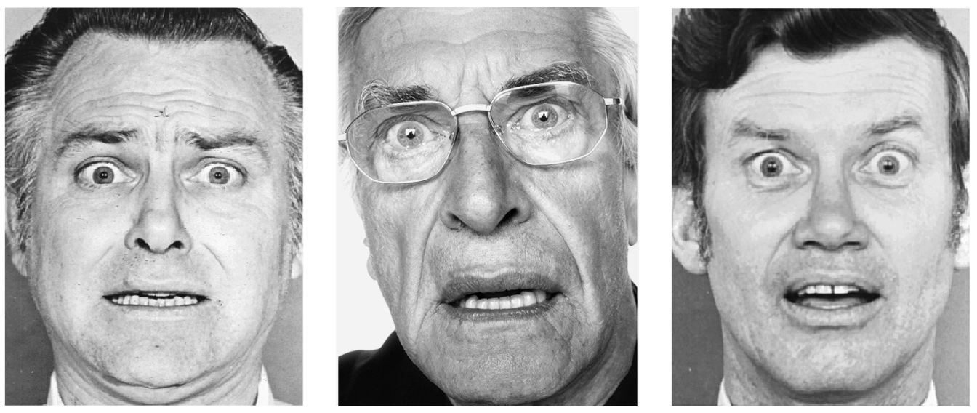
Fear or surprise
Title: Presentation
Subtitle field

Slide 15
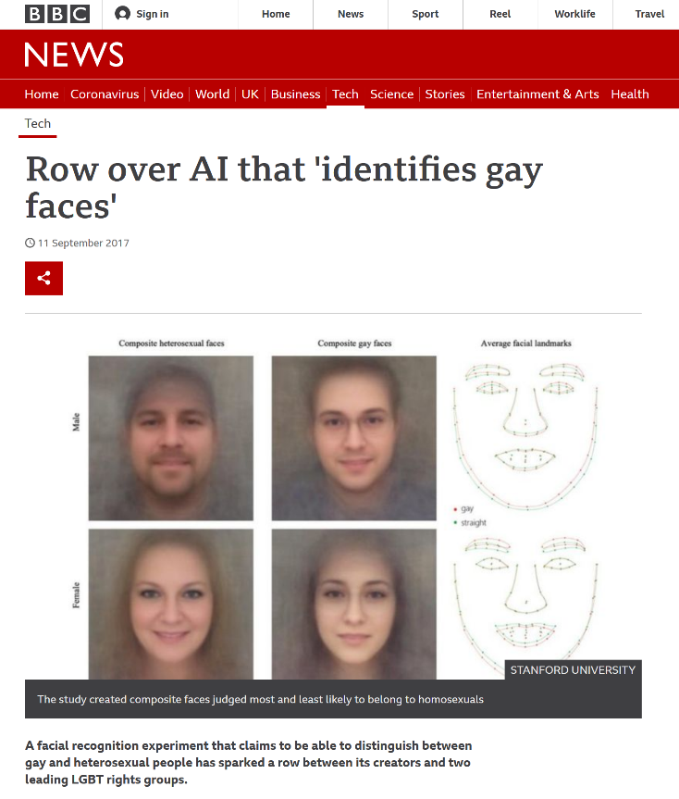
Is big data phrenology?
Title: Presentation
Subtitle field

Slide 16
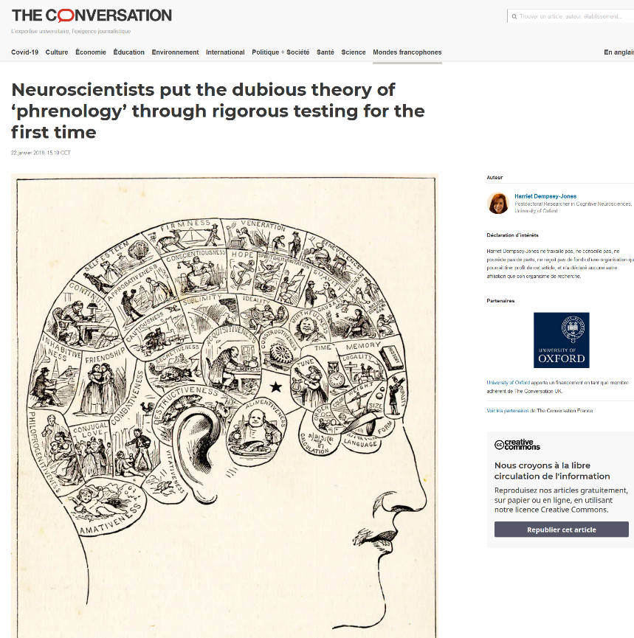
Is big data phrenology? (cont.)
Title: Presentation
Subtitle field

Slide 17
Individual Negative externalities
Title: Presentation
Subtitle field
Identity theft
Hacks
Harassment
Blackmail
Spam
Business secrecy
Ethics (e.g. Target)
Price discrimination and targeting

Slide 18
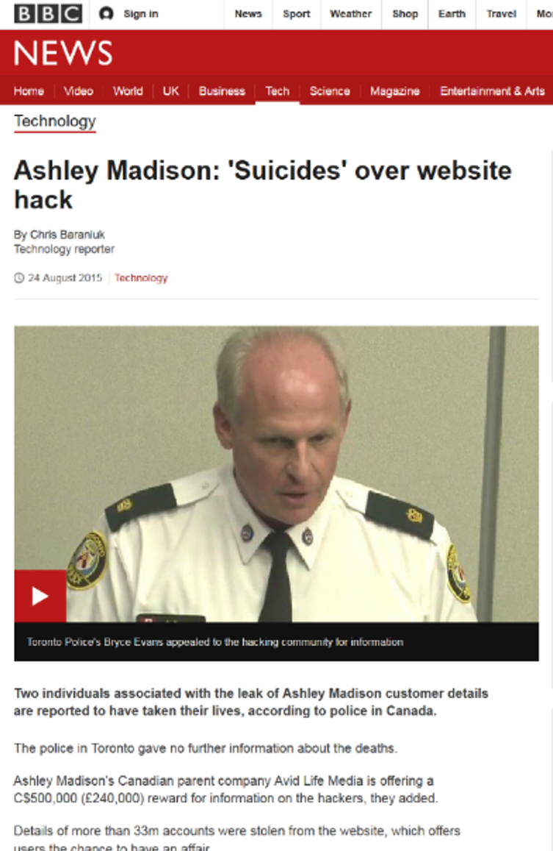
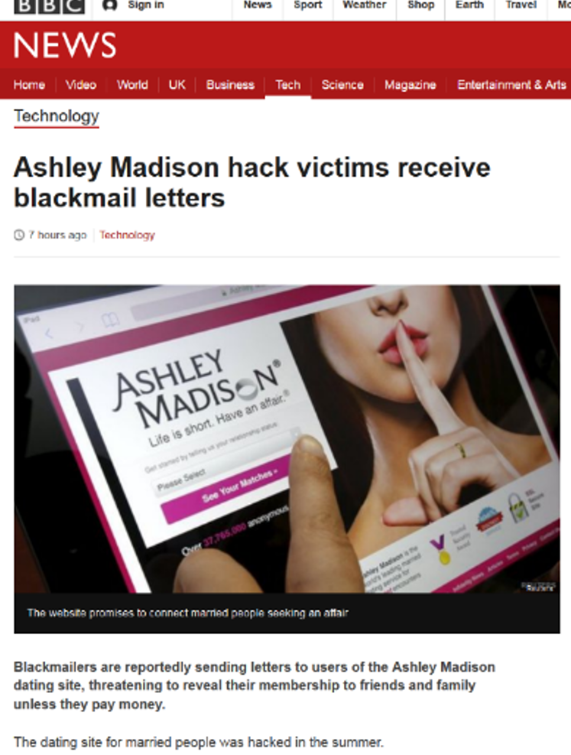
Hacks, blackmail
Title: Presentation
Subtitle field

Slide 19
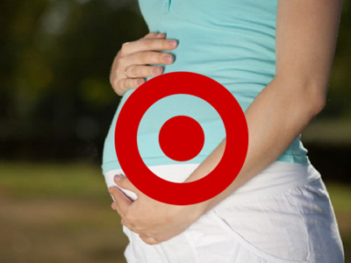
Target pregnancy coupons
Title: Presentation
Subtitle field
Man receives coupons for pregnancy products in his mailbox
Complains at Target customer service
Finds out that her daughter was in fact pregnant

Slide 20
Externalities (cont.)
Title: Presentation
Subtitle field
Group externalities:
DNA testing
Gmail
Social scoring
Externalities at the society level:
Fake news
Violent content
Polarization of opinions
Shortening of attention span

Slide 21
Title
Subtitle

